Slide 1
Category review: Chips
AUGUST 2025
Retail Analytics
Brand note: If client logo is not required, use alternate title page layout right click slide thumbnail > Layout > Title

Slide 2
Notes:
To view Privacy video explaining how important data privacy is to Quantium, please click here: https://www.youtube.com/watch?v=Zq1QDAkoRzU
or here Q:\Company Reference\Brand & Design\Brand videos\Q Privacy.mp4
At Quantium, we believe that data is the behavioural footprint of humanity and that it has to be treated with the utmost care and responsibility.
Histories, attitudes, indeed lives are stored within it in ways that aren’t always apparent – and that’s what makes its potential so powerful.
To work with it responsibly, sensitively, we set ourselves the highest data privacy protection and governance standards.
We have spent 17 years perfecting privacy-by-design and secure-by-design principles. Central to this is not holding any personally identifiable information about people –
we neither receive it, and put the necessary protections in place to be unable to decipher it.
Every aspect of handling data is safeguarded: from its de-identification, to its encryption – data security is paramount and of the highest grade.
We pride ourselves on gaining the trust of iconic organisations around the world through years of securely working with their data,
and in turn the trust that builds with their stakeholders.

Slide 3
Executive summary
Chips Sales and Customer Spending Behaviour Analysis.
Mainstream Category customers provide the maximum sale almost 1.5 times Premium Category customers while Premium and Budget Category customers being in same range with Budget customers being higher.
The Brand KETTLE dominates over every other brand in the stock in every metric such as total sale, customer category, and customers of different life stages.
Pack size of 175g is most preferred in chips category which is by far most sold, dominated among customers preference, With an exception of PRINGLES being sold maximum in 134g category.
Store number 211,76, 11, 252, 206, 92, 193, 85, 31 are the worst performing stores with them performing almost 1.5% of highest selling stores.
01
02
Analysis of Trial Layout in Stores 77, 86 and 88 in comparison to Control stores
Trial Store 77 shows the growth in Total sales by almost 28% and Customers grown by almost 24.6%, which is the highest among all three selected trial stores.
Trial Store 86 and 88 have shown quite similar result, they have shown positive trend in both metric, with sales being 8.2% and 12.3% respectively and customers growth being 6.2% and 7.5%.
All three stores have experienced positive growth but the sales declined between march and April 2019.

Slide 4
01
Chips Sales and Customer Spending Behaviour Analysis

Slide 5
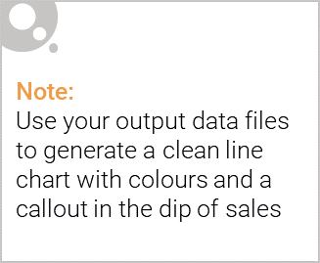
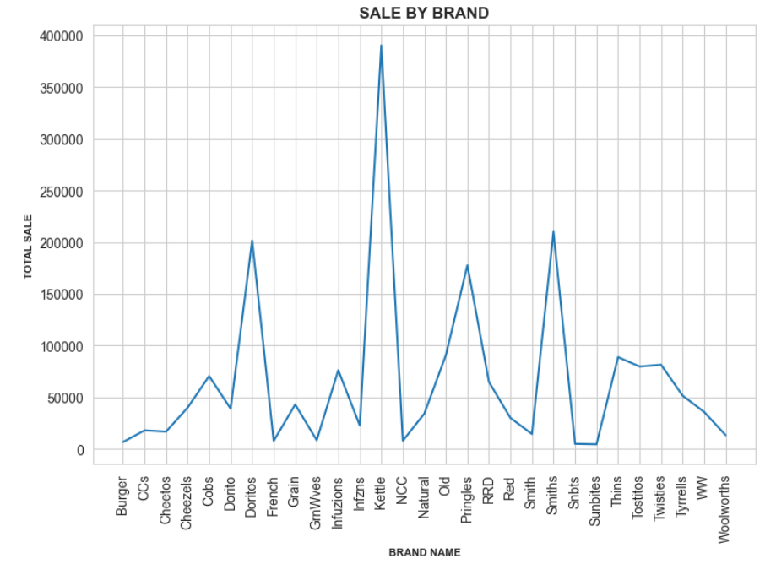
SALE ANALYSIS BY BRAND
1.KETTLE exceed all other brand
in total sales by HUGE margin
with close to being almost double
of second higest i.e. SMITHS
2. Other top brands after KETTLE
are SMITHS, DORITOS and
PRINGLES
3. Some of the least performing
brands are Burgers, Sunbites
and Smith.

Slide 6

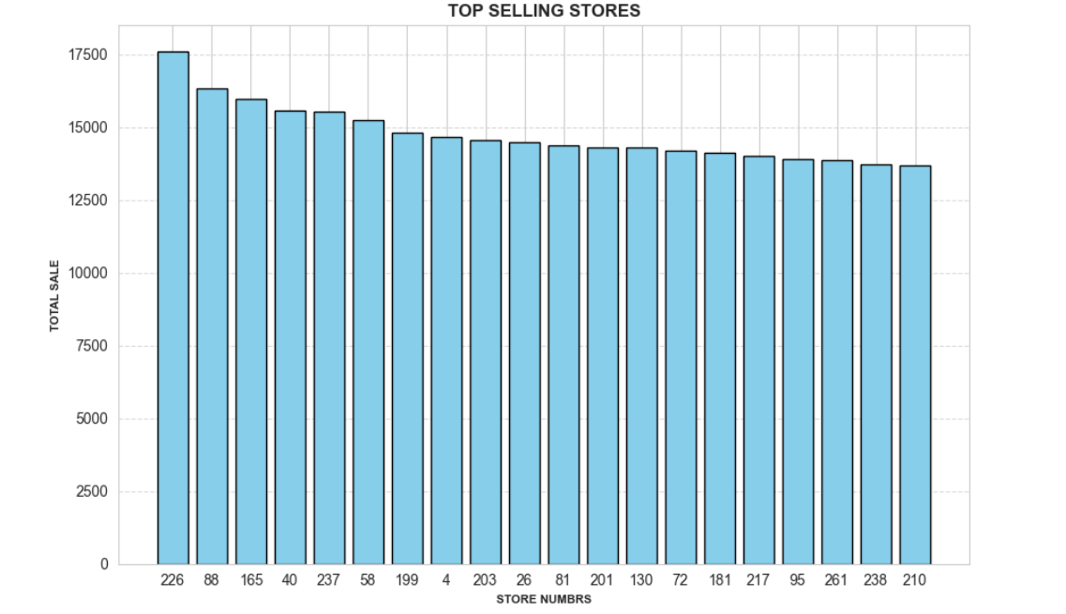
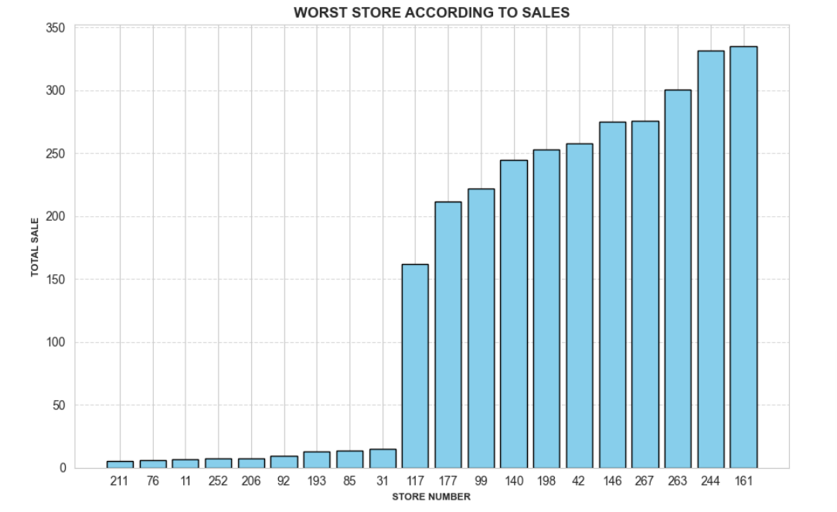
WORST PERFORMING STORES SHOULD BE CLOSED DOWN AS LESS THAN 0.15% SALE OF HIGHEST PERFORMING STORES.
PERFORMANCE OF STORES IS CONSISTENT AMONG THE CUSTOMERS CATEGORY AND LIFESTAGES.

Slide 7
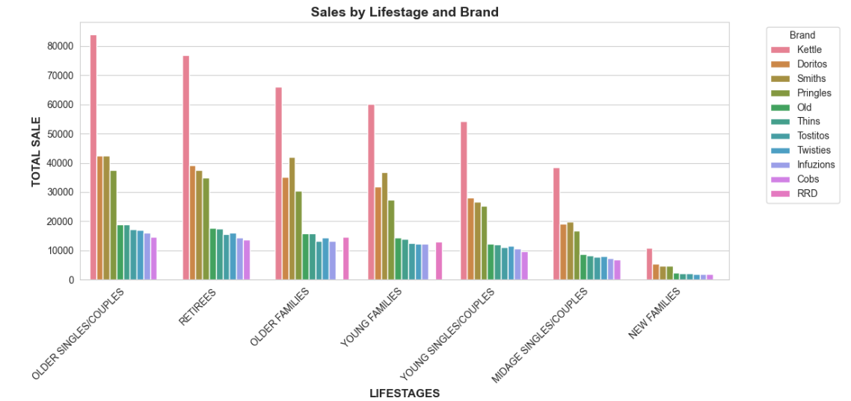
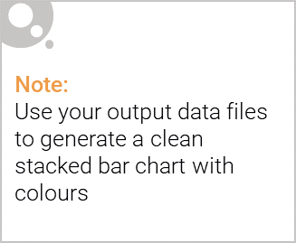
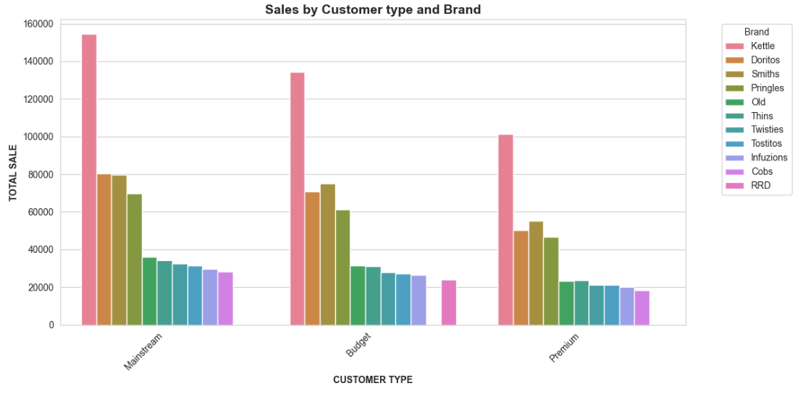
Editable (delete this)
1.OLDER SINGLE/ COUPLES MAKE THE MOST SPENDING CUSTOMERS AND THAT TOO OF MAINSTREAM CATEGORY.
2. THE CATEGORY DOES NOT MAKE MUCH DIFFERENCE IN SALES.
3. RETIREES AND OLDER FAMILIES AMONG OTHERS FOR KEY DRIVER OF SALE

Slide 8
02
Trial Store Performance

Slide 9
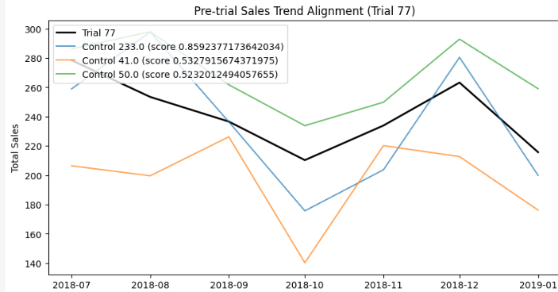
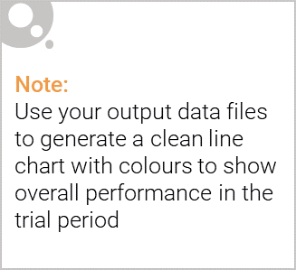
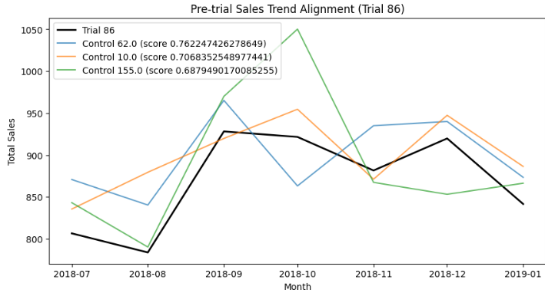
1.Based on Correlation and Difference between Trial and Control stores, top 3 were selected.
2. From those top 3 the most aligned store is selected and scaled for further analysis of Trial period.

Slide 10
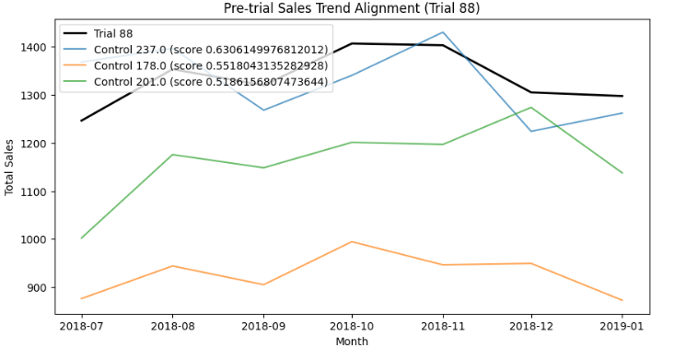
CONTROL STORE SELECTION
Control Stores 233 , 62 and 237 were selected for Trial store 72,86 and 88 for analysis during Trial period of Feb 2019 to April 2019.

Slide 11
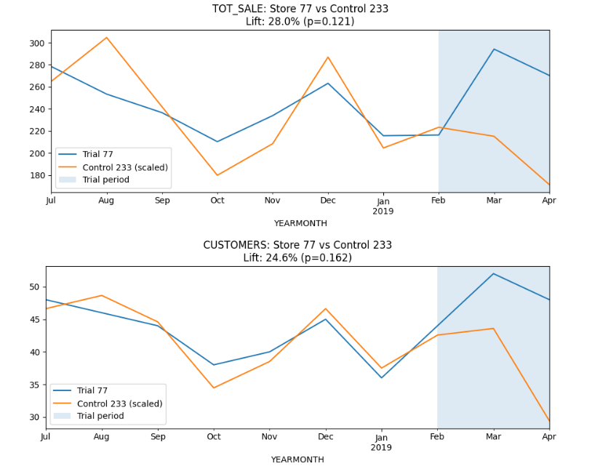
TRIAL STORE 77 vs CONTROL STORE 233 DURING TRIAL PERIOD
Trial Store 77 shows the growth in Total sales by almost 28% and Customers grown by almost 24.6%, which is the highest among all three selected trial stores.

Slide 12
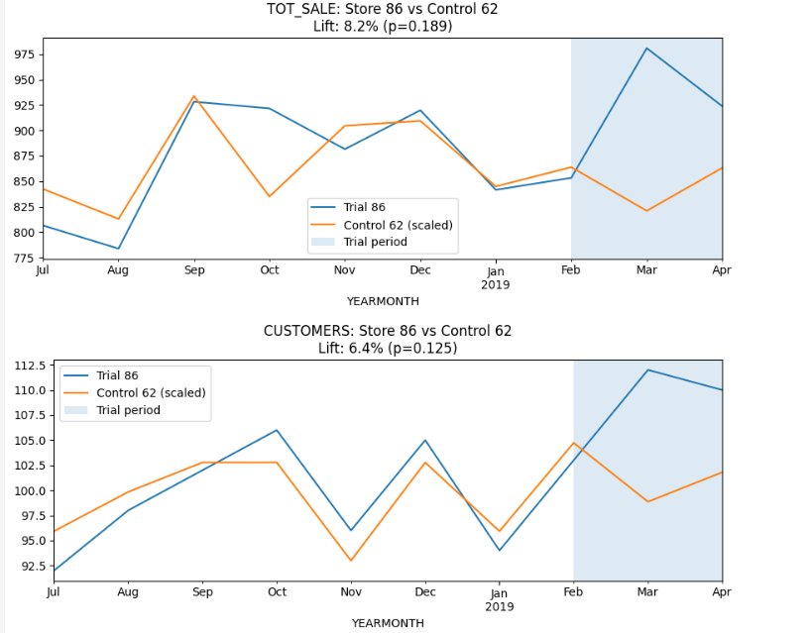
TRIAL STORE 86 vs CONTROL STORE 62 DURING TRIAL PERIOD
Trial Store 86 shows the positive growth in Total sales by almost 8.2% and Customers grown by almost 6.4%, which is the lowest among all three selected trial stores.

Slide 13
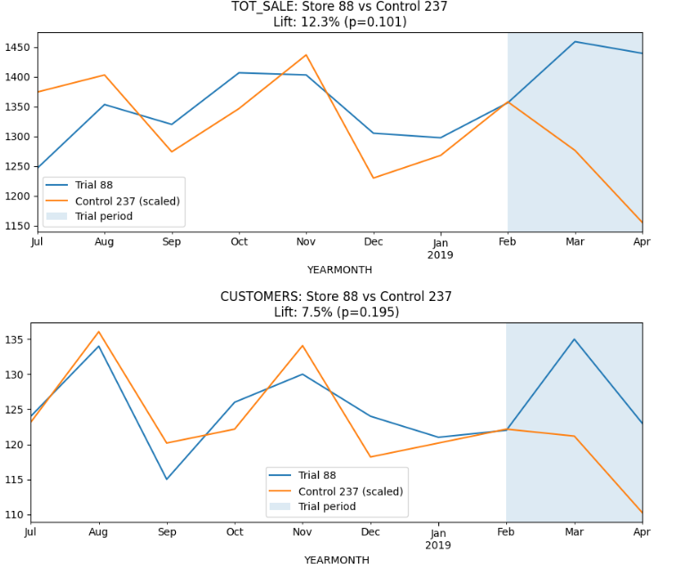
TRIAL STORE 88 vs CONTROL STORE 237 DURING TRIAL PERIOD
Trial Store 88 shows the positive growth in Total sales by almost 12.3% and Customers grown by almost 7.5%, which is the considerably higher than store 86 performance considering store 88 was second highest in overall sales already.

Slide 14
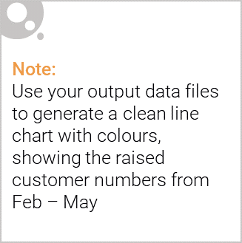
RECOMMENDATIONS
Kettle, Smiths, Doritos and Pringles brand Chips must be pushed more.
Pack size of 175g is recognised as most preferred size, with pringles preferred more in 134g.
Store number 211,76, 11, 252, 206, 92, 193, 85, 31 are the worst performing stores with them performing almost 1.5% of highest selling stores.
OLDER SINGLE/ COUPLES MAKE THE MOST SPENDING CUSTOMERS AND THAT TOO OF MAINSTREAM CATEGORY. RETIREES AND OLDER FAMILIES AMONG OTHERS FOR KEY DRIVER OF SALE
Stores such as 233, 41, and 50 with similar functionality as store 77 must be pushed with trial layout with full force as they have high potential.

